Slide 1
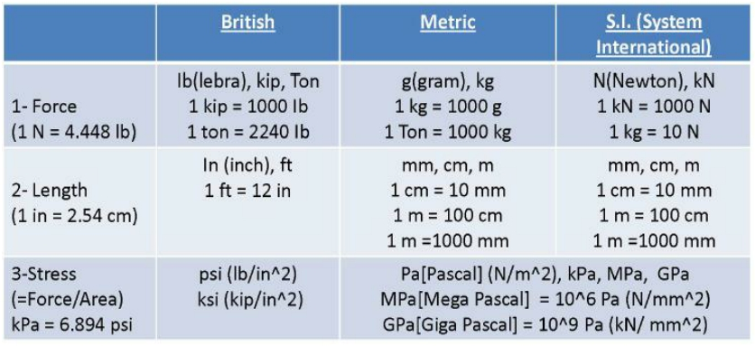
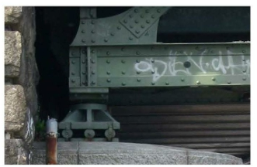
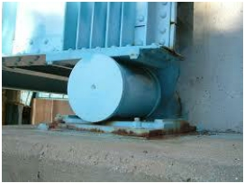
Units تادحولا
Types of supports used in structures:
1. Roller Support:
Figures show roller supports in bridge

Slide 2
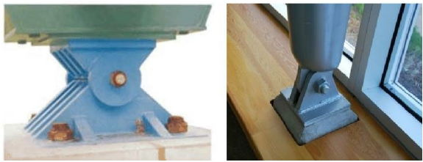
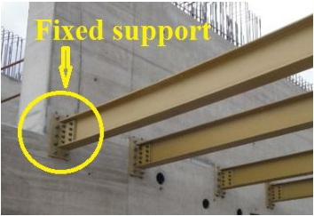
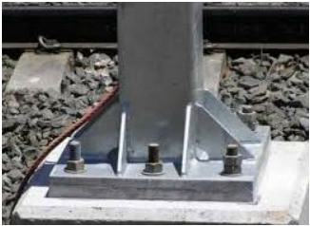
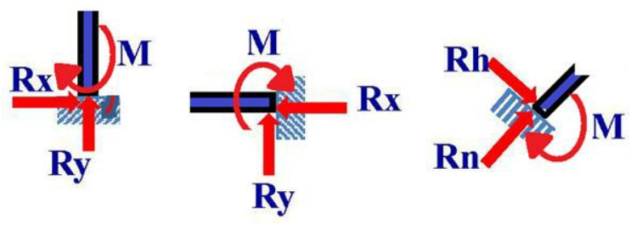
2. Pin or hinge Support:
Figures show pin supports
3. Fixed support:

Slide 3
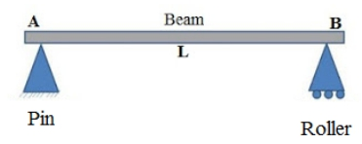
Classification of structures
1. Beams
Beam is defined as the structural member which is used to bear different loads. It resists the vertical loads on the beam, shear forces and bending moments.
Types of beams
1. Simply supported beam
2. Cantilever beam
3. Fixed beam
4. Overhanging beam

Slide 4
5. Continuous beam
2. Frames:
Frame is type of structure consists of beams and columns:

Slide 5
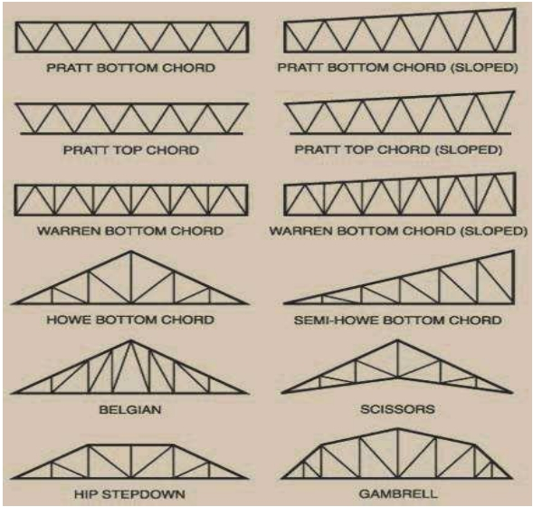
3. Trusses:
A truss is a structure consists of parts or members bear only axial loads (either tension or compression)

Slide 6
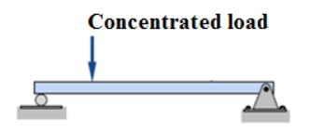
Types of Loading
Loads applied to the beam may consist of a concentrated load (force applied at a point), uniform load, uniformly varying load, or an applied couple or moment. These loads are shown in the following figures:
1. Concentrated load
2. Uniform load
3. Uniformly varying load
4. Moment

Slide 7
Strength of Materials
References
(1) "Strength of Materials", Ferdinand L. Singer, 3rd Edition, 1980.
(2) " Introduction to mechanics of Solids”, Paul E. Popov, 1990.
(3) "Elements of Strength of Materials", S. Timoshenko
(4) " Mechanics of Materials", Ferdinand P. Bear, E. Russell Johanston, Jr. ,John T. DeWolf and David F. Mazurek, 6th Edition, 2012.
Strength of materials:
Strength of materials extends the study of forces that has begun in engineering mechanics the difference between engineering mechanics and strength of materials is that engineering mechanics cover relations between forces acting on rigid bodies, while strength of materials deals with the relations between externally applied loads and their internal effects on bodies. Also the bodies are no longer assumed to be ideally rigid. The deformations, however small are of major interest.
Simple Stresses
Stress is difine as the intensity of force. Simple stress is expressed as the ratio of the applied force divided by the resisting area.
Stress = Force / Area
It is measured by unit force over unit area
It is measured in British units by psi or ksi or other units, and in SI unit by (kN/m2) or (N/m2=Pa) or (N/mm2=MPa) or other units.
Simple stress can be classified as :
1. Normal stress
2. Shear stress
3. Bearing stress
1. Normal stress
This type of stress develops when a force is applied perpendicular to the cross- sectional area of the material. There are two types of normal stresses; tensile

Slide 8
stress and compressive stress. Tensile stress applied to bar tends to elongate the body , while compressive stress tend to shorten the body as shown in the Fig. below:
The magnitude of normal stress is calculated by the formula:
where σ is the normal stress, P is the applied normal load and A is the area.

